Slide 1
Things we remember from our days at PAHO Believe it or not
Para conmemorar el 120 aniversario de la OPS, colegas jubilados han compartido historias de su tiempo de trabajo en la Organización. Estas historias pueden parecer inusuales para los estándares actuales e ilustran las formas en que la OPS ha evolucionado a los largo de los años
To commemorate PAHO's 120th anniversary, retired colleagues have shared stories of their time with the Organization. These stories may seem unusual by today's standards and illustrate the ways in which PAHO has evolved over the years.

Slide 2
Things we remember from our days at PAHO Believe it or not
Gloria Coe
Gloria Silvestre Khokhar
Clarkson Parker
Magda C. Rodríguez
Mena Carto
Christian Darras
Mirta Roses
Juan Manuel Sotelo
Enrique Fefer
Helena Restrepo Espinoza
Carlos Bobba Bonatti
Gina Watson
Martha Peláez
Gina Watson
Katherine Cocco
Gloria Morales
Sumedha Khanna
Violeta Mata
Hortensia Saginor
Haidee Olcese
Marilyn Rice
María Mercedes Rodríguez
Y comparte la tuya…

Slide 3
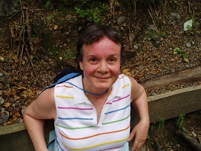
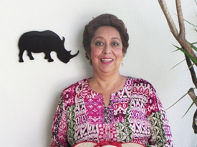
Things we remember from our days at PAHO Believe it or not
Health sells and attracts audiences.
Fascinating to work with 10-12 important Latin American TV news journalists attending a PAHO & USAID seminar on health journalism and observe their determination to broadcast topics on health rather than on disease, illness and treatment (Gloria Coe).
In the old times (maybe 70 and 80's) there used to be a very kind and funny guy working at the mail room. His name was Johnny Walker (Juanito El caminador). As he used to go to Watergate to drop the mail and pick up some mail, he would buy mail stamps to sell from his office. He would not add any charges, he would do it as a favor to the staff!
So nice of Johnny... Those were the times! (Gloria Silvestre Khokhar).

Slide 4
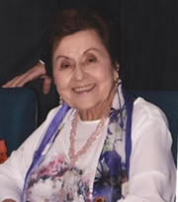
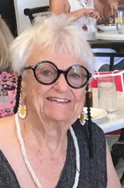
Things we remember from our days at PAHO Believe it or not
En 1982, cuando llegué a trabajar a sede de la OPS, la única mujer de alto nivel era Sumedha Khanna. Al irse ella, solamente quedamos dos, un P4 y un P5.
El ambiente era increíblemente masculino. Uno de los hombres asesores me reclamó por qué, siendo yo una secretaria, le enviaba una nota de carácter técnico (Helena Restrepo Espinoza).
Guyana has more undiscovered terrain and is one of the most exotic counties in the world. In 1978, the Guyanese military flew us by helicopter over thick dense forest to see peoples impossible to reach by land. Travelling on Guyana’s Essequibo River in 1978, we were told not to hang our feet over the edge of the boat because the pariah fish would tear the flesh off our bones (Theresa Miller).
In a local hotel in Georgetown, Guyana, the PAHO Team worked day and night for several months in 1978 in a small room without air conditioning to compile findings, use data to make charts, and identify key issues for consideration of the Ministry of Health.

Slide 5
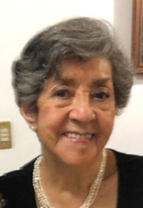
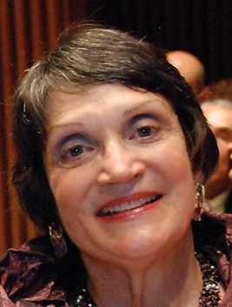
Things we remember from our days at PAHO Believe it or not
Trabajar en la OPS/OMS me dio la oportunidad de hacer muy buenas amigas. Algunas de ellas las conocí desde principios de los años 60s cuando todas empezamos en la OPS/OMS.
En los años 60s se preparaban las estadísticas en una calculadora manual inmensa. En un papel cuadriculado o papel logarítmico, se hacían gráficas con información recibida de los países.
En el Depto. de Malaria teníamos una mesa de dibujo para la preparación de las gráficas y los mapas que se utilizaban para los informes sobre Malaria (Hortensia Saginor).
When I joined PAHO in 1978, we used typewriters, and we communicated with the countries by expensive telephone calls, fax that required special training of the secretaries, or pouch.
All correspondence had multiple copies with boxes at the bottom for supervisors to initial before they could be sent. For each of my trips, I took scissors, scotch tape, and draft letters to complete during my downtime in the DC and Miami airports and on the plane ride to Miami.
I used this time to finalize my correspondence and reports by writing long-hand. With scissors and scotch tape, I cut and taped the final copy that I sent by USPS snail mail from the Miami airport to my secretary to finalize (Marilyn Rice).

Slide 6
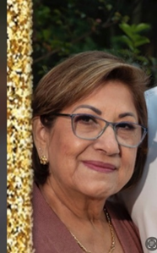
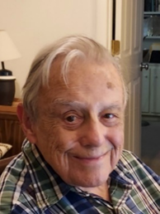
Things we remember from our days at PAHO Believe it or not
En diciembre, para ponerle un poco de sal y pimienta a las festividades de fin de año, el Departamento de Finanzas durante su almuerzo de navidad hacia un programa de burla con humor acerca de varias personas, pero dejando un mensaje fuerte (Magda Rodríguez).
During my service as Representative to Trinidad and Tobago, from 1968 to 1970, there was a "black power" uprising.
PAHO staff stayed safely at home, though a Molotov cocktail was thrown into the courtyard of one house (Clarkson Palmer).

Slide 7
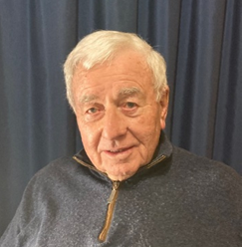
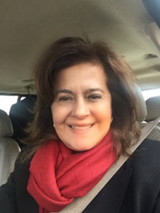
Things we remember from our days at PAHO Believe it or not
Trabajó en la OPS/OMS entre 1957 y 1988 como Oficial Técnico en los programas contra la malaria en Centro América, Ecuador, Paraguay, República Dominicana y Panamá.
Managua destruida en 1972, El Consultor llegó y se sentía un intruso en mi casa. Le dije que si armaba su carpa, lavaba sus platos y comía su ración diaria no habría problemas (Carlos Bobba Bonatti).
En Colombia en 1977, los anuncios de vacantes OPS se hacían en el periódico y lo gane, ingrese el día de mi cumpleaños, doble regalo (María Mercedes Rodríguez).
En aquel entonces, se usaba la taquigrafía. Las máquinas de escribir IBM, y el fax; qué tiempos aquellos.
En 33 años aprendí mucho en OPS, terminé como Administradora de Empresas, Oficial de Recursos Humanos y una bella familia.

Slide 8
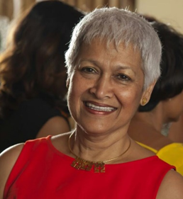
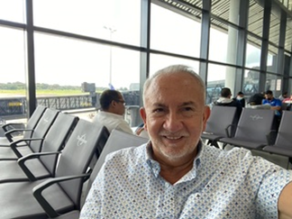
Things we remember from our days at PAHO Believe it or not
During my time at PAHO Guyana from 1985 – 2000, almost every national election was followed by protests and violence by the losing party – including storming the largest police station directly across from the PWR office. To protect our staff, the driver dropped each person home safely then myself as Administrator, the PWR, and the Environmental Engineer drove home in a convoy – to protect one another.
There was a bittersweet sense of excitement given the warm feeling of caring in our PAHO Guyana family! (Mena Carto).
Me ha tocado contribuir al diálogo entre partes en conflicto. Dos ejemplos: La dura huelga médica con abandono de servicios de atención en Bolivia en 1987 que se resolvió en una cena en mi casa a la que invité al Ministro de Salud y los dirigentes del gremio médico y, la participación personal en las mesas de concertación en salud durante la crisis compleja en Argentina en el 2001 en que hubo colapso del gobierno y desmoralización generalizada de la población.
Estos logros institucionales solo se pueden alcanzar cuando hay credibilidad y confianza en la OPS (Juan Manuel Sotelo).

Slide 9
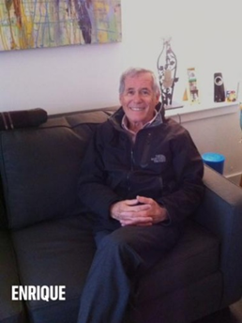
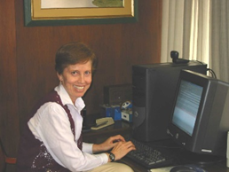
Things we remember from our days at PAHO Believe it or not
To arrange duty travel you could go to the Travel Office on the second floor and talk to the travel agent who knew you and your travel preferences. No recorded messages of "your call is important to us.”
Coat and tie were de rigueur for men - no walking the halls in shirt sleeves (Enrique Fefer).
Professionals were assigned a weekend to come to the office and check the telex machine in the basement to see if there was an urgent message requiring the attention of the Director or the appropriate senior staff. Fortunately, I never received such a message.
En la época del cólera teníamos una computadora por unidad y se archivaba con disquetes que debían ser formateados. Una colega dejó su disquete junto a la PC y vino otro colega y por error formateó el diskette ajeno, y se perdió la información del muestreo de 4 meses (Haidee Olcese).
De 1979 a 2010 en OPS había un equipo de cómputo enorme luego las PC monocromáticas, las policromáticas; máquinas de escribir eléctricas de bolita, luego con corrector y pasaron al olvido; télex, fax y correo electrónico. Avance de tecnología

Slide 10
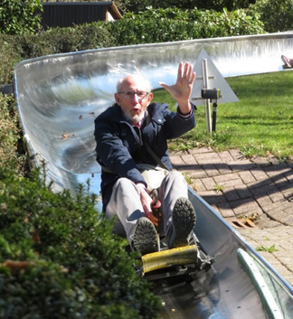
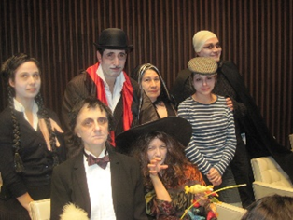
Things we remember from our days at PAHO Believe it or not
After working in Europe and Africa, I was surprised on arriving in Latin America to find public health specialists were particularly proud to have stopped serving patients in hospitals.
For them, it was necessary to concentrate on improving the general living conditions of their patients. For my part, I kept looking for a continuum between these two dimensions of work (Christian Darras).
En la OPS trabajamos duro y también nos divertimos mucho. Para celebrar “Halloween” en 2010, mi equipo se disfrazó de la familia Adams, ¡¡bailó tango y ganó el primer premio!!
At PAHO we worked hard and had a lot of fun too. Celebrating Halloween in 2010, my team dressed and acted as the Adams family, we danced tango and won the first prize!! (Gloria Morales)

Slide 11
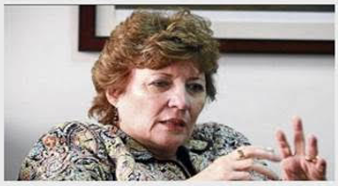
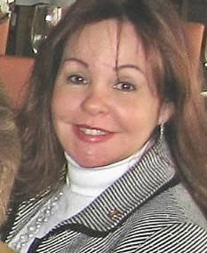
Things we remember from our days at PAHO Believe it or not
As an epidemiologist at CAREC in 1984, urgent news was shared via TELEX. Emerging diseases and outbreaks reports flowed constantly between Country offices, Centers, Washington and Geneva WHO HQs. Staff on duty had the role to read and act on weekends and holidays (Mirta Roses).
Como epidemióloga en CAREC (1984) las noticias urgentes se trasmitían por TELEX. Informes de enfermedades trasmisibles y brotes circulaban entre las Oficinas de país, Centros, Washington y Ginebra continuamente; se asignaba personal de guardia en feriados y fines de semana para leer y actuar en consecuencia.
Para la década de los 70 la Oficina OPS en la Republica Dominicana pertenecía al Área II, México. La correspondencia era enviada desde Washington en "pouch" a la Oficina de Área y luego de ser revisada e iniciada por el Jefe de Área la enviaban a DOM (Catherine Cocco).
Tomaba aproximadamente de 4 a 6 semanas recibir una correspondencia. Asuntos de suma importancia, siempre de procedencia del Director, llegaban ciertos días de la semana vía télex.
¡Aun así solíamos decir que estábamos muy ocupados!

Slide 12
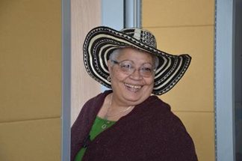
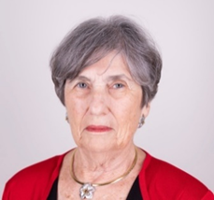
Things we remember from our days at PAHO Believe it or not
I spent 26 amazing years learning, working, and meeting wonderful people some of whom are now members of extended family. Working with Sir George Alleyne gave me confidence and strength when he was both AD and D (Gina Watson).
I once unexpectedly met Sir George at an airport who asked, “where is your PAHO pin,” It went from my bag to my lapel in 10 seconds. The greatest lesson was his response, “it is part of your identity – always wear it.” Lesson learned. Working with Dr Carissa Etienne brought a very human spiritual identity, giving our best in good and trying times, and never alone
Learning the PAHO culture was a challenge since I was coming from many years working in Academia.
Dr. Solis’ advice as my supervisor, was precious. He simply said: You are the expert in your field. On a day-to-day basis, do what you need to do. As in all institutions it is easier sometimes to say, “I’m sorry” than to get permission to do what needs to be done” (Martha Pelaez).

Slide 13
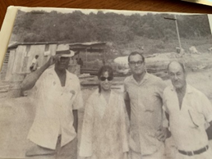
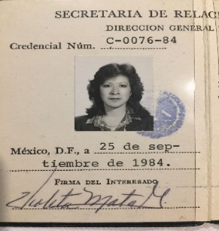
Things we remember from our days at PAHO Believe it or not
Once, working in the hinterlands of Guyana, our Ministry of Health and PAHO health team including me as PWR, met a woman who urgently needed an emergency Caesarian section. Since the nearest hospital was too far, we took her to a small district community health center and as I was still quite fresh from my clinical Ob/Gyn specialty, I performed her C-section (Sumedha Mona Khanna).
A un año de haber ingresado a la PWR-México, tuve la oportunidad de experimentar vivencialmente el rol de la OPS/OMS a nivel internacional, en el desastre natural del “Terremoto de 1985”.
La coordinación para recibir el apoyo internacional, así como intercambiar información sobre situación de familiares de becarios, funcionarios, asesores temporales, etc., se realizaba a través de un Radio de Onda Corta (terremoto net) cuya transmisión funcionaba solamente en la azotea del edificio de 12 pisos (Violeta Mata).

Slide 14
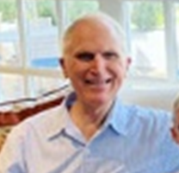
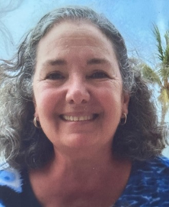
Things we remember from our days at PAHO Believe it or not
In Oct. 1973 in the Health Statistics Department, I verified mortality sheets of 26-28 member countries summing deaths vertically by cause and horizontally by age and sex.
Without a calculator! (Tom Yerg).
Coordinating the US/Mexico Border Office, with thanks for grant funds, we were able to work with families grieving the loss of members killed by violence.
Children were engaged in arts and crafts exhibited at community centers (Maria Teresa Cerqueira).

